Slide 1
Secure Your Cloud with Confidence
Deep Dive into
Azure Security Management
David Branscome
dabran@microsoft.com

Slide 2
Agenda
Newest additions to Defender for Cloud: Defender CSPM and Defender for DevOps
Defender for Containers and Kubernetes Attack Matrix
Automating Security with Defender for Cloud and Logic Apps
Database and Storage Protection with Microsoft Defender for Storage

Slide 3
Newest additions to Defender for Cloud:
Defender CSPM
Defender for DevOps

Slide 4
Defender for Cloud:
Cloud Security Posture Management

Slide 5

Foundational vs Defender CSPM
Feature | Foundational | Defender CSPM | Cloud availability
Continuous assessment of the security configuration of your cloud resources |  |  | Azure, AWS, GCP, on-premises
Security recommendations to fix misconfigurations and weaknesses |  |  | Azure, AWS, GCP, on-premises
Secure score |  |  | Azure, AWS, GCP, on-premises
Governance |  |  | Azure, AWS, GCP, on-premises
Regulatory compliance |  |  | Azure, AWS, GCP, on-premises
Cloud security explorer |  |  | Azure, AWS
Attack path analysis |  |  | Azure, AWS
Agentless scanning for machines |  |  | Azure, AWS

Slide 6
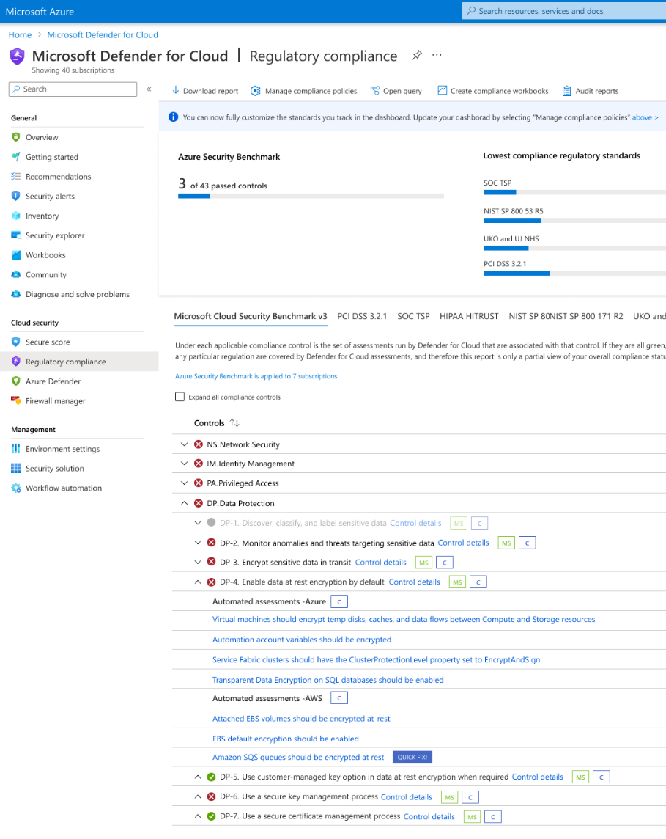
Security governance and regulatory compliance
Policies ensure organizational compliance with laws and regulations established by external bodies (e..g, government)
Continuously assesses hybrid cloud for risk factors based on controls and best practices

Slide 7
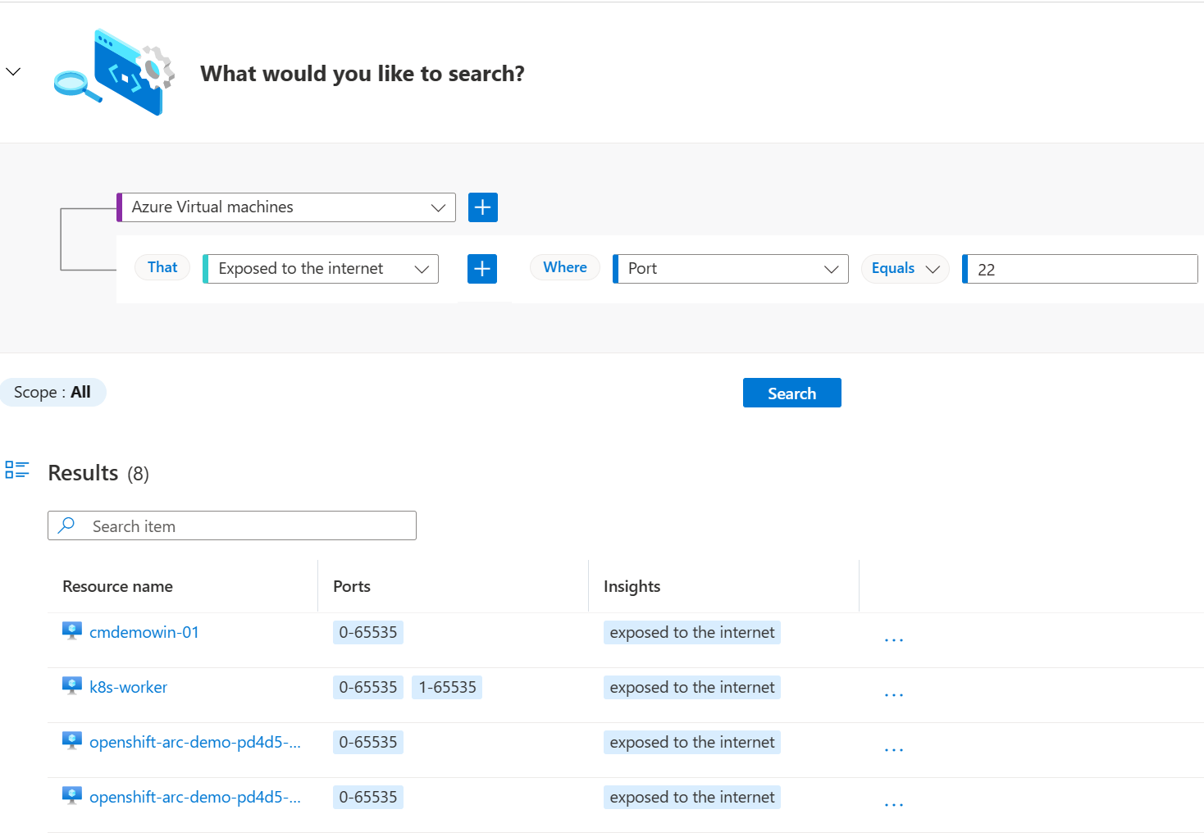
Cloud Security Explorer
Collects data from multicloud environment and other data sources
Helps you identify weaknesses, vulnerabilities and misconfigurations in deployed assets
Feeds Attack Path Analysis

Slide 8
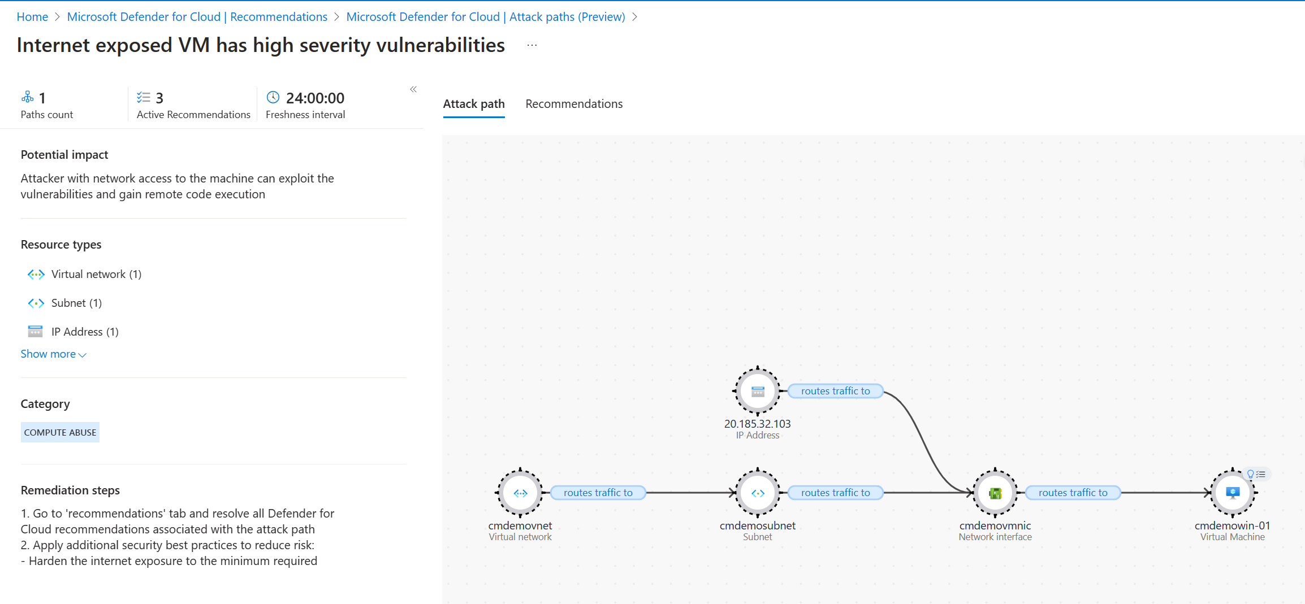
Attack Path Analysis

Slide 9
DEMO

Slide 10
Defender for DevOps

Slide 11
Customer challenges
Fragmented visibility
Over 54% of enterprises do not integrate security in DevOps pipelines ¹
More than half of enterprises are concerned over rogue applications and compute instances ²
Lack of insights
Pervasive silos
Over 34% of enterprises lack developer buy-in due to inadequate automation and prioritization ³
Over 50% of enterprises indicate DevOps and security silos as the biggest challenge
to implement DevSecOps ⁴
1. Microsoft Enterprise DevOps Report
2. SANS 2022 Cloud Security Survey
3. Rethinking the Sec in DevSecOps: Security as Code A SANS Survey
4. Rethinking the Sec in DevSecOps: Security as Code A SANS Survey

Slide 12

Empower security teams with unified DevOps security management across multipipeline and multicloud environments
Unify visibility into DevOps security posture
Strengthen cloud resource configurations
Automate with integrated security intelligence

Slide 13
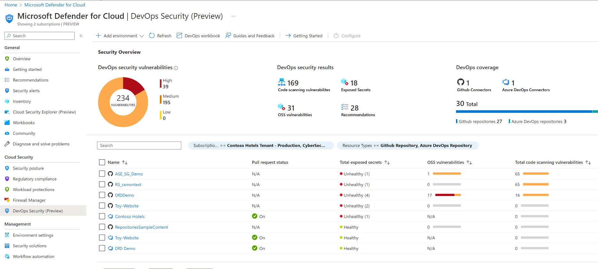
Unify visibility into DevOps security posture

Slide 14
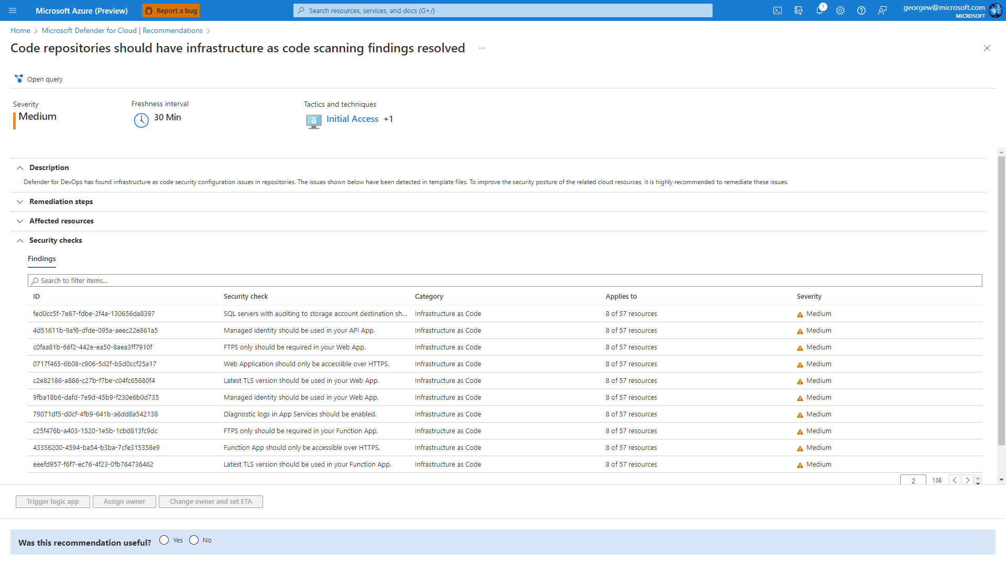
Strengthen cloud resource configurations in code

Slide 15
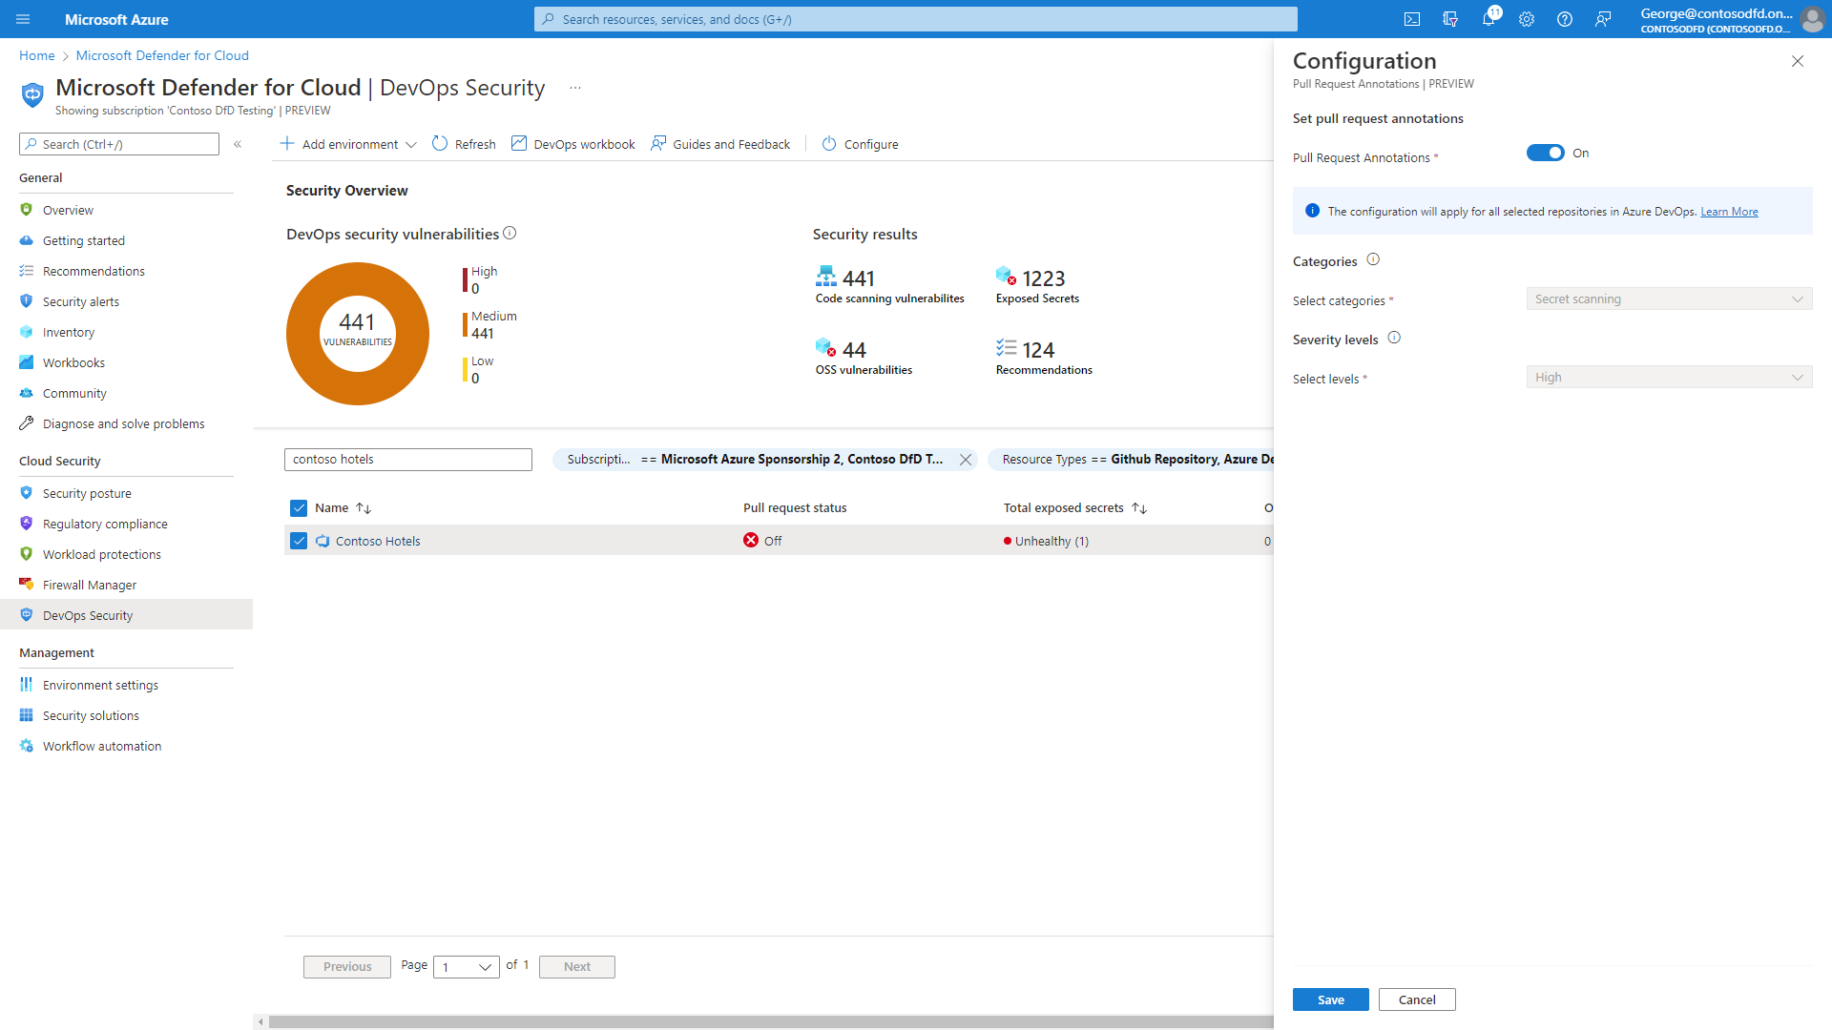
Automate with integrated security intelligence

Slide 16
DEMO

Slide 17
Defender for Containers

Slide 18
Containers and Kubernetes 101

Slide 19
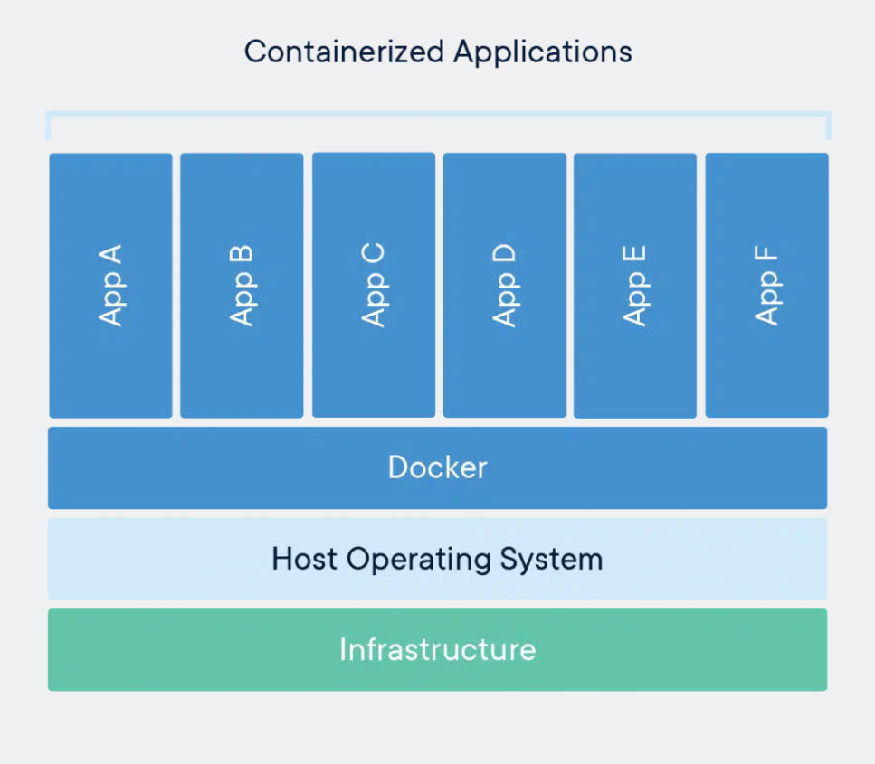
What are containers?
A container image is a standard unit of software
Containers package up code and all its dependencies, so applications can be deployed reliably in any computing environment
A container is created from an image (template or blueprint for creating containers)
Multiple containers can share a single OS kernel

Slide 20

Why containers?
“Works on my machine”
Every environment looks the same
Increased velocity
Runs anywhere

Slide 21
What is a container registry?
A repository for storing container images
Public registries i.e., Docker Hub are free & easy
Private registries allow for efficient and secure storage

Slide 22
Why Kubernetes?
Cluster Management:
deploy and manage cluster resources
Scheduling: where containers run
Lifecycle and Health:
keep containers running despite failure
Naming and Discovery:
where are my containers
Load Balancing:
evenly distribute traffic
At the end of the day, we need something to help us with all the orchestration..
An orchestrator!
Scaling:
make sets of containers elastic in number
Image repository:
centralized, secure Docker container images
Continuous Delivery:
CI/CD pipeline and workflow
Logging and Monitoring:
track what’s happening in containers and cluster
Storage volumes:
persistent data for containers

Slide 23
How Kubernetes works
Cluster
Kubernetes control
Node
kubelet
kube-proxy
Internet
Kubernetes cluster consists of worker machines, called nodes
Control plane
Docker
Nodes run containerized apps. Each cluster has at least one worker node.
Pod
Pod
API server
Containers
Containers
Worker nodes host pods, which are the components of the application workload
-controller-manager
-scheduler
Node
kubelet
kube-proxy
Internet
replication, namespace, serviceaccounts, etc.
etcd
Control plane manages the worker nodes and the pods via the API server and the kubelet.
Docker
Pod
Pod
Containers
Containers
Kubernetes Components | Kubernetes

Slide 24
Securing Containers

Slide 25
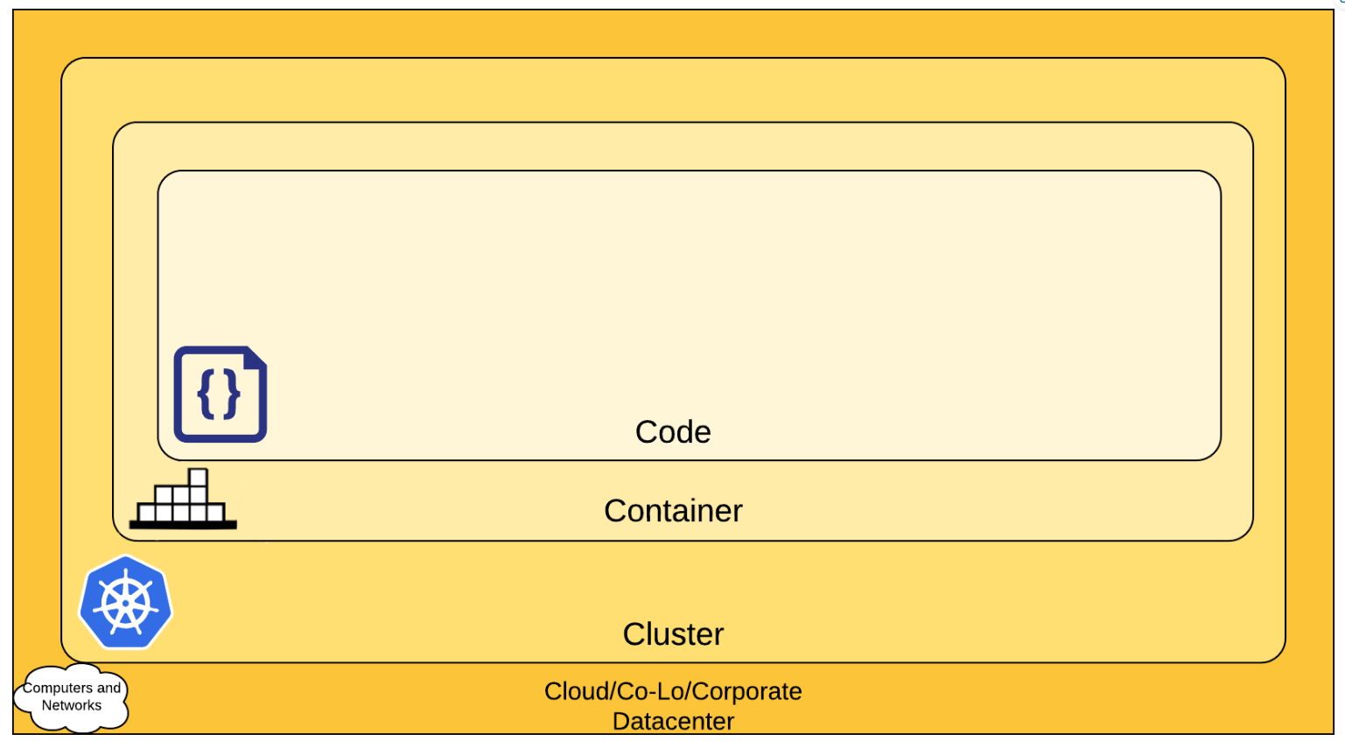
Container security is different
50% of container images get replaced in one week or less¹
Ephemeral environment
  Applications are elastic, containers are short lived, spawn and re-size rapidly
  Container images are immutable, software updates require creation of new images
High demand for visibility and control
  Containers traffic flows are difficult to track with traditional tools
  Runtime environment includes rich data and controls, with different configuration layers
Unique expertise needed
  A shortage of skilled labor
  Steep learning curves for open-source container tools and platforms
~44% of containers live less than five minutes!¹
¹ 2022-cloud-native-security-and-usage-report

Slide 26


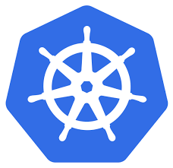
Threat landscape for managed Kubernetes
CI/CD
Portal/CLI
Vulnerable or miss-configured images
Common attack techniques
Compromised Account
Abuse over-permissive roles\SA
Exploit vulnerable images
Deploy backdoor containers
Exploit application
Escape to the host
Control Plane API
Data Plane API
Unauthorized Traffic
Kubernetes Cluster
API Server
Node
Node
Node
App Level Attack
Node Level Attack
Control Plane
Worker Nodes
Provides core Kubernetes services and orchestration of application workloads
Execution Environment
Run application workloads
Environment misconfiguration

Slide 27
Security Recommendations
Build
Scan images in CI/CD
Ship
Scan images in registry
Deployment
Use Kubernetes Admission Controllers
Monitor for abnormal activity
Runtime
Restrict Kubernetes API access
Patch vulnerabilities
Use trusted base images
Secure registry
Configure RBAC for registry
Ensure containers are immutable
Continuously scan running containers
Block vulnerable images
The goal: Ensure that container environment is running as intended, including protection of infrastructure, software supply chain, runtime, and everything in-between

Slide 28
Defender for Containers

Slide 29



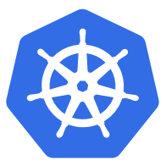
Microsoft Defender for Containers
Container Vulnerability Assessment
Seamless deployment and configuration - Discover ACR registries, scan all pushed images, continuous scanning of active images and visibility to vulnerable images
Runtime Protection
Detect suspicious behavior in Kubernetes workloads via a unique agentless approach leveraging Kubernetes audit log, in addition to Kubernetes workers dedicated detections
Hardening Hosts, Cluster hygiene
Harden & audit AKS clusters according to Azure Security Benchmarks and follow Docker CIS benchmark on container nodes
Kubernetes Policy & Enforcement
Admission control policy management - Mandate/audit security best practices on Kubernetes workloads

Slide 30
Kubernetes attack matrix
Initial access | Execution | Persistence | Privilege escalation | Defense evasion | Credential access | Discovery | Lateral Movement | Impact
Using cloud credentials | Exec into container | Backdoor container | Privileged container | Clear container logs | List K8S secrets | Access the K8S API server | Access cloud resources | Data destruction
Compromised images in registry | Bash / cmd inside container | Writable hostPath mount | Cluster-admin biding | Delete K8S events | Mount service principle | Access Kubelet API | Container service account | Resource Hijacking
Kubeconfig file | New container | Kubernetes CronJob | hostPath mount | Pod / container name similarity | Access container service account | Network mapping | Cluster internal network | Denial of service
Application vulnerability | Application exploit (RCE) |  | Access cloud resources | Connect from Proxy server | Applications credentials in configuration files | Access Kubernetes dashboard | Applications credentials in configuration files
Exposed dashboard | SSH server running inside container |  |  |  |  | Instance Metadata API | Writable volume mounts on the host
 |  |  |  |  |  |  | Access Kubernetes dashboard
 |  |  |  |  |  |  | Access tiller endpoint
https://www.microsoft.com/security/blog/2020/04/02/attack-matrix-kubernetes/

Slide 31
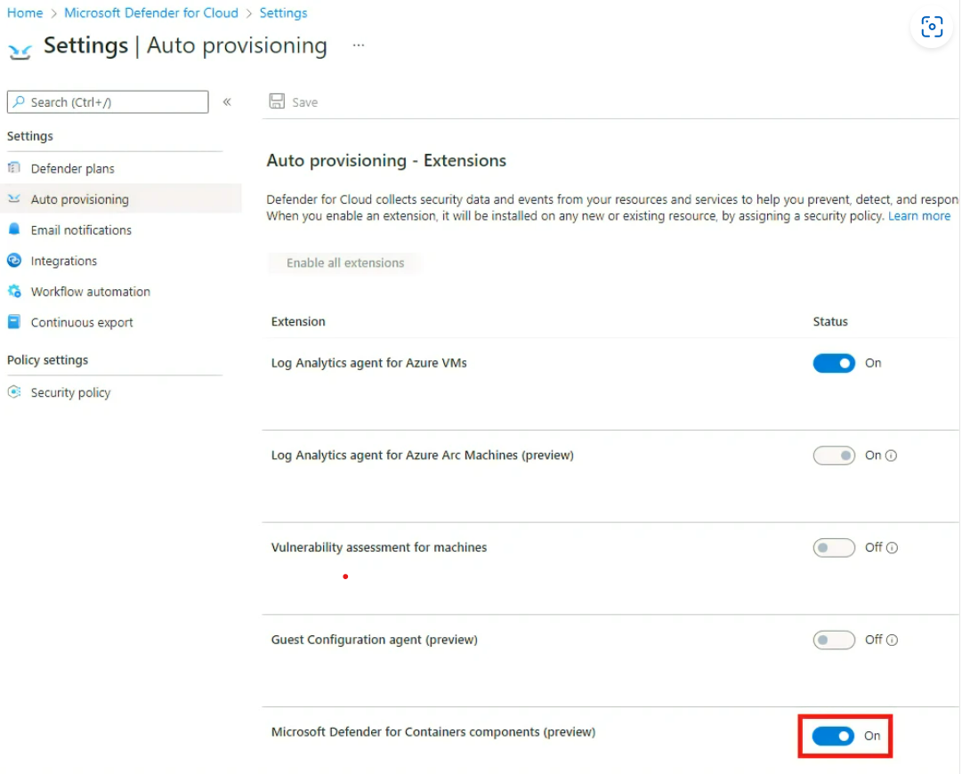
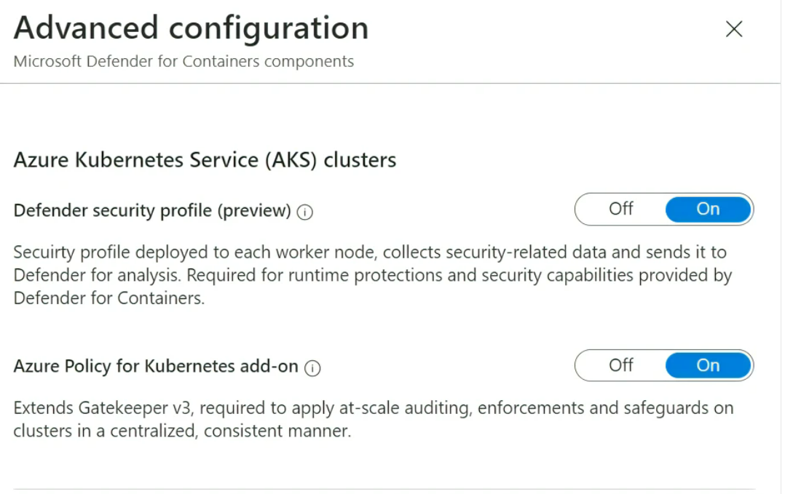
Native integration with Azure Kubernetes Service (AKS)
Defender security profile provides runtime protections and collects security signals and events from worker nodes.
Azure Policy for Kubernetes add-on extends Gatekeeper, applies at-scale enforcements and safeguards on AKS clusters in a centralized, consistent manner

Slide 32
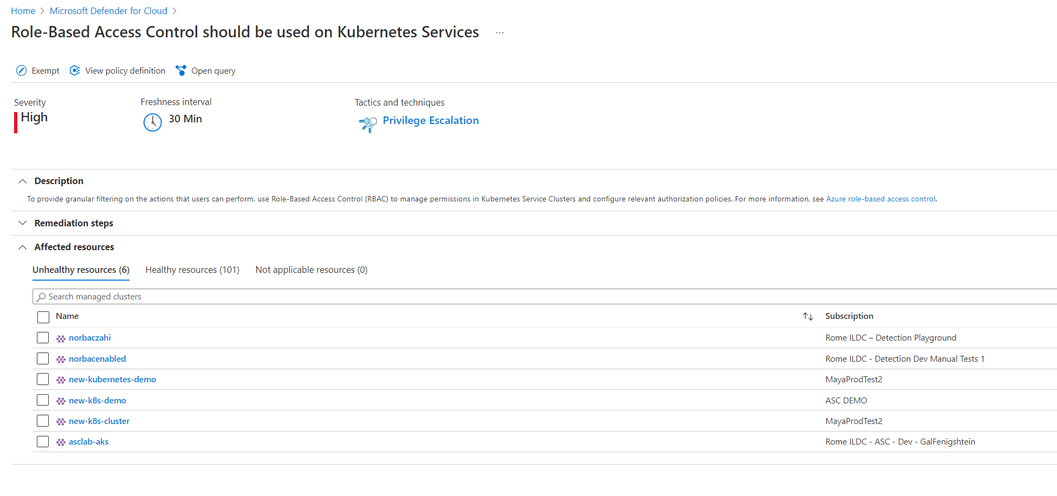
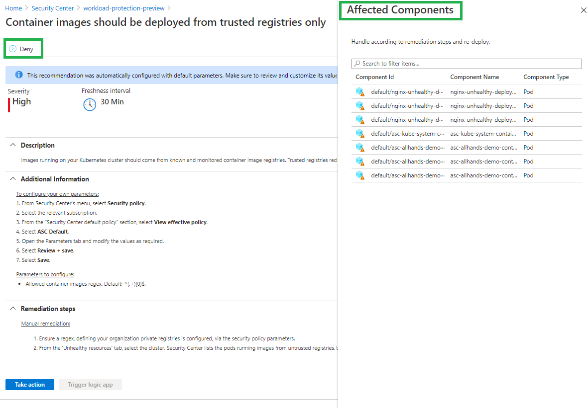

Hardening
Secure Score
Understand the bottom line of your security posture
Prioritized view of containerized assets’
security posture
Control plane recommendations
Harden and audit according to Azure
Security Benchmarks
Follow Docker CIS benchmark on container nodes
Data plane recommendations
Audit or enforce Kubernetes workload security
best practices

Slide 33
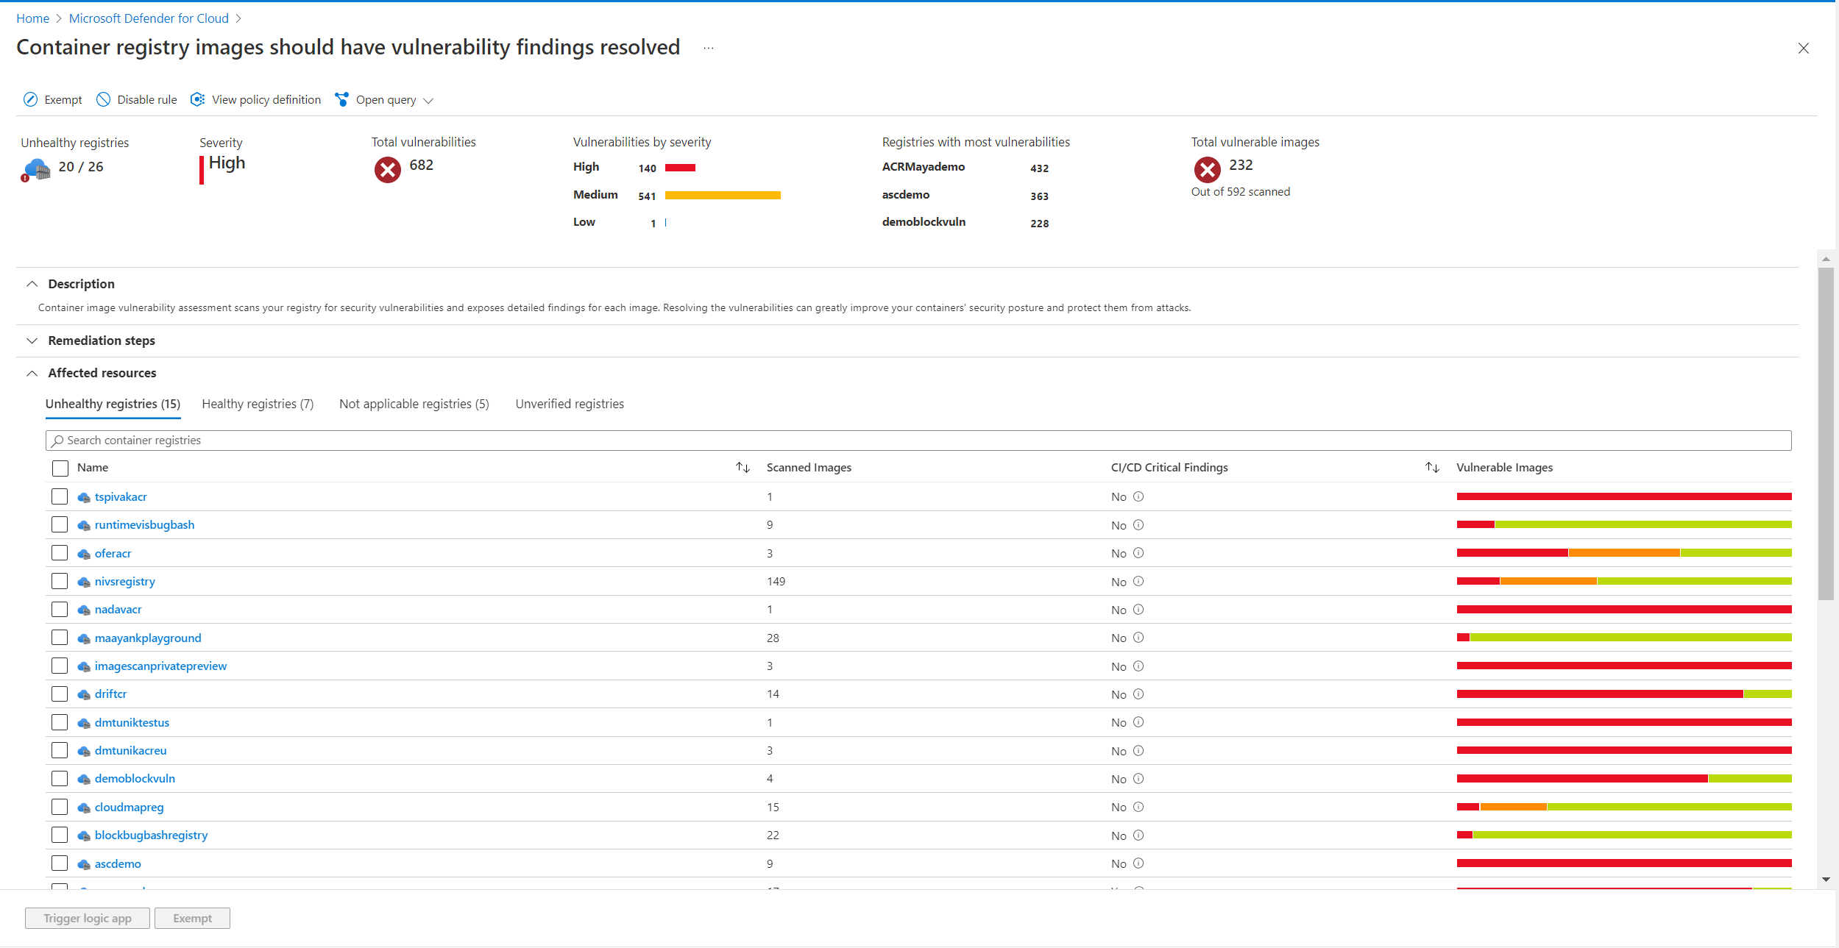
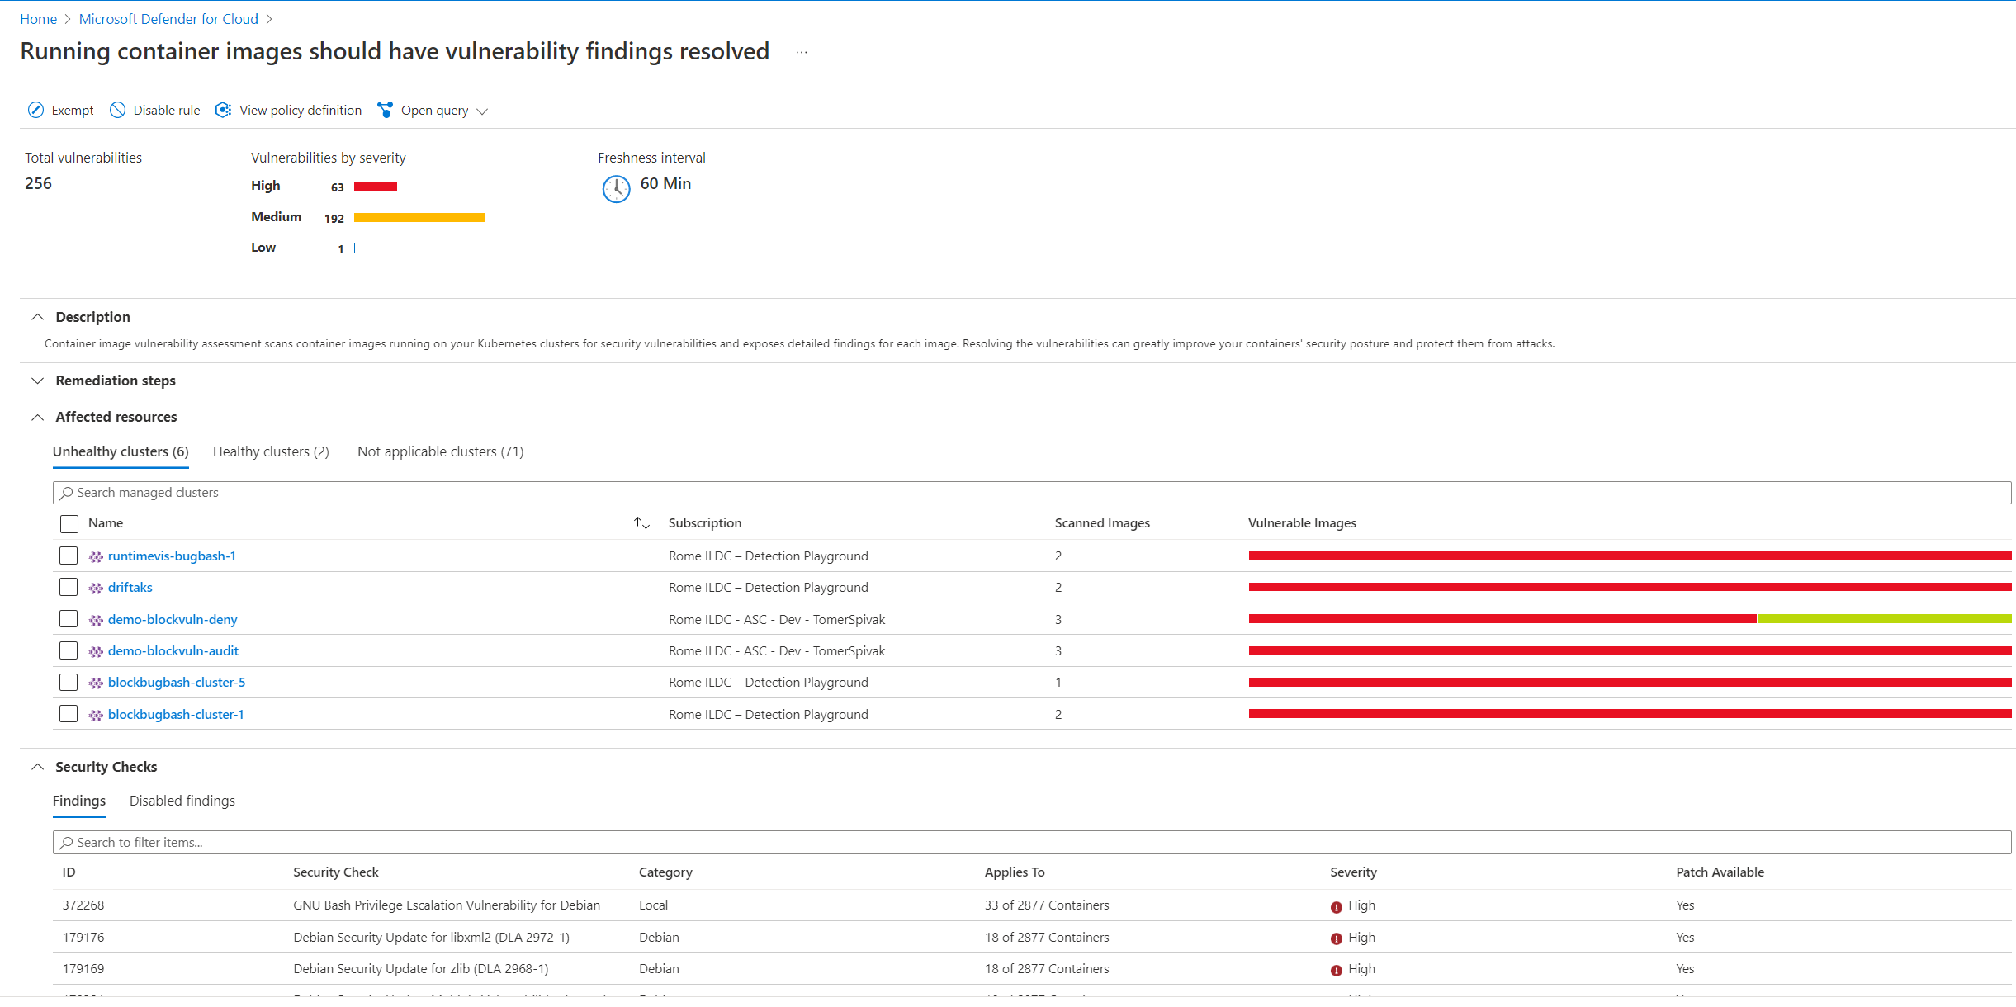

Vulnerability management
Unique value proposition
Automatic onboarding of registries, zero configuration
Images remain within the customer’s region in Azure
Images remain within the customer’s account in AWS
Ship
New container images are automatically scanned
Birds-eye view for all registry vulnerabilities
Runtime
Continuous scanning of images running in AKS clusters
Visibility to image vulnerabilities in AKS clusters
Build
Scan your images as part of your CI/CD pipeline with Defender for DevOps

Slide 34
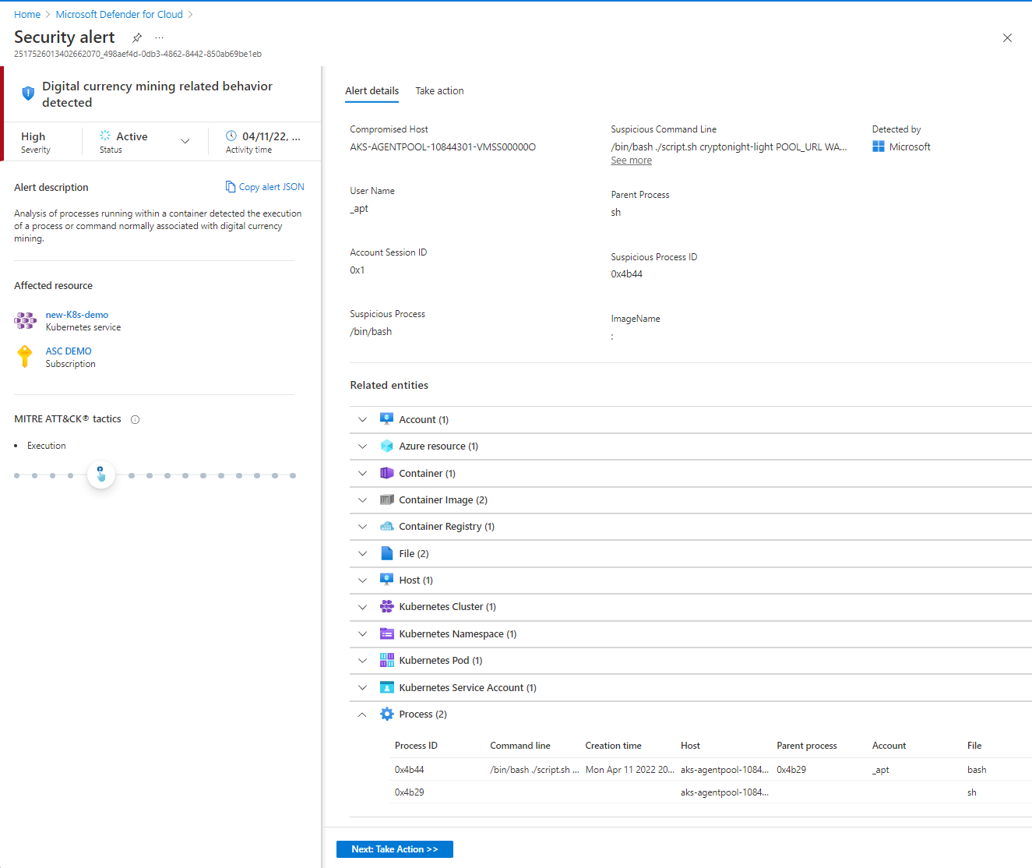
Advanced threat detection
Rich detection suite
Control plane and workload level detections
Deterministic, AI, and anomaly-based alerts to
identify threats
Leading threat intelligence
Microsoft’s global threat intelligence with honeypot
networks, research malware feeds, in addition to memory forensic techniques to identify fileless attacks
Understand risk and context
Prioritized alerts mapped to MITRE ATT&CK® tactics
to easily understand the Kubernetes context effect across
the attack lifecycle and to identify response action
Automate response
Automate actions with tools of your choice: SIEM
integration, email notifications, workflow automations
and continuous export

Slide 35
Automating Security with
Defender for Cloud and Logic Apps

Slide 36
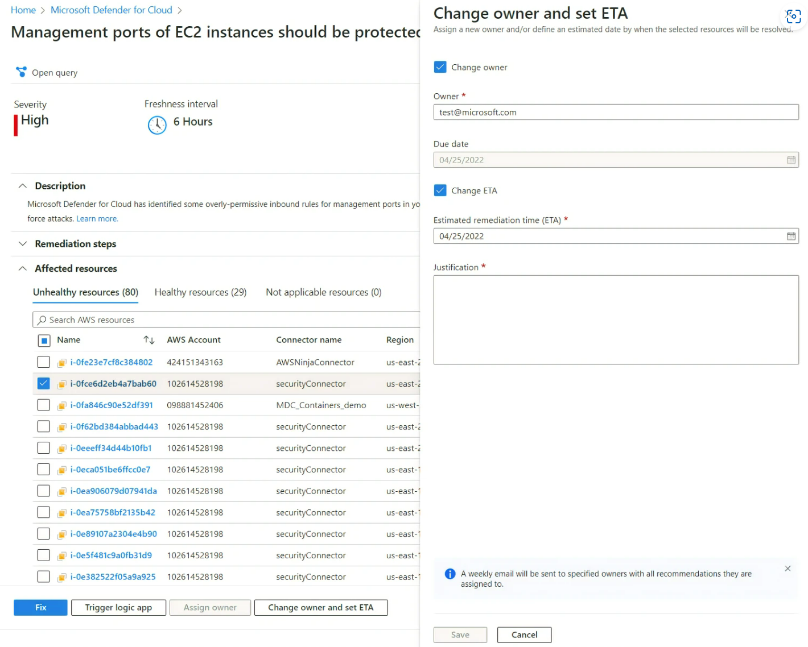
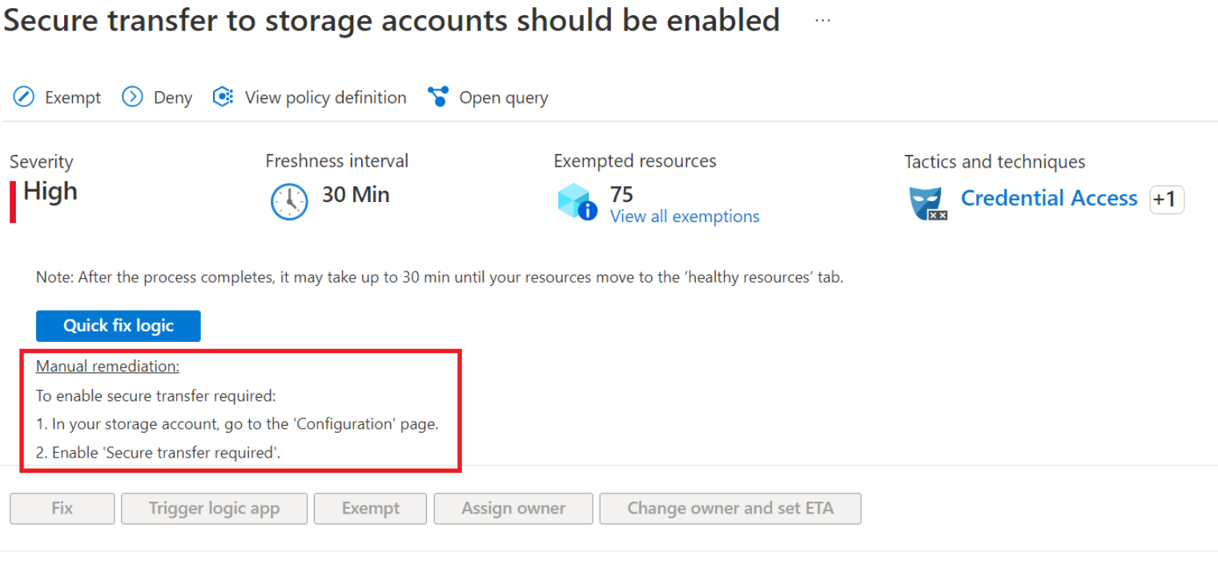
Defender for Cloud Recommendations
Management and remediation of recommendations can be done manually
  Set an owner for the issue
  Set estimated remediation date
May be required due to complexity of the issue or change control requirements
Automation speeds resolution and standardizes approach

Slide 37
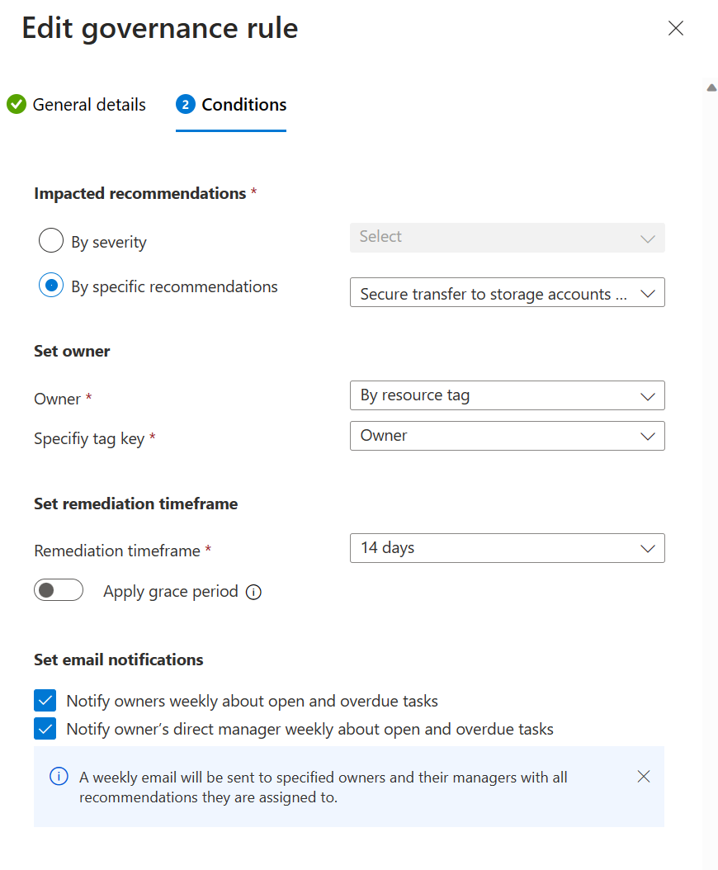
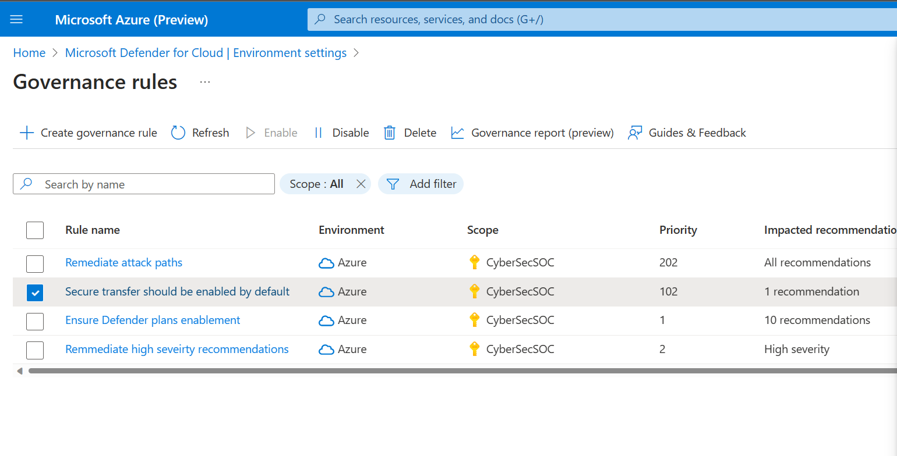
Build an automated remediation process with governance rules
Automate the process of defining who should own remediation of certain issues, assign a severity level, and set a target due date

Slide 38
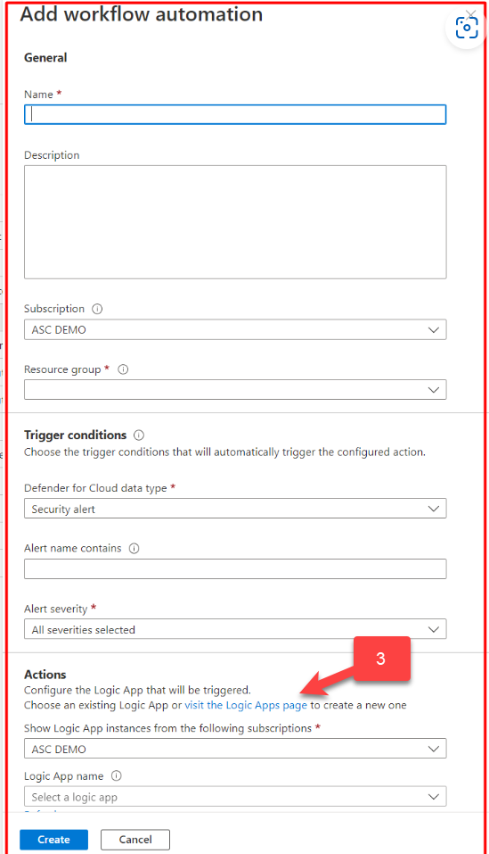
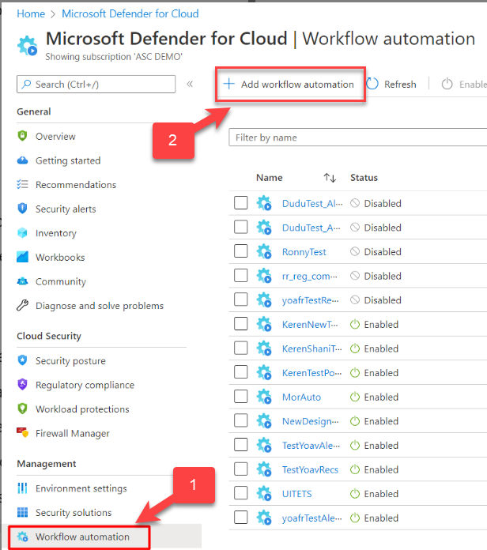
Automate remediation of common issues
Open Workflow automation blade
Add a workflow automation
Open the Logic Apps designer tool
You’ll be asked to define where you want to create the Logic App

Slide 39
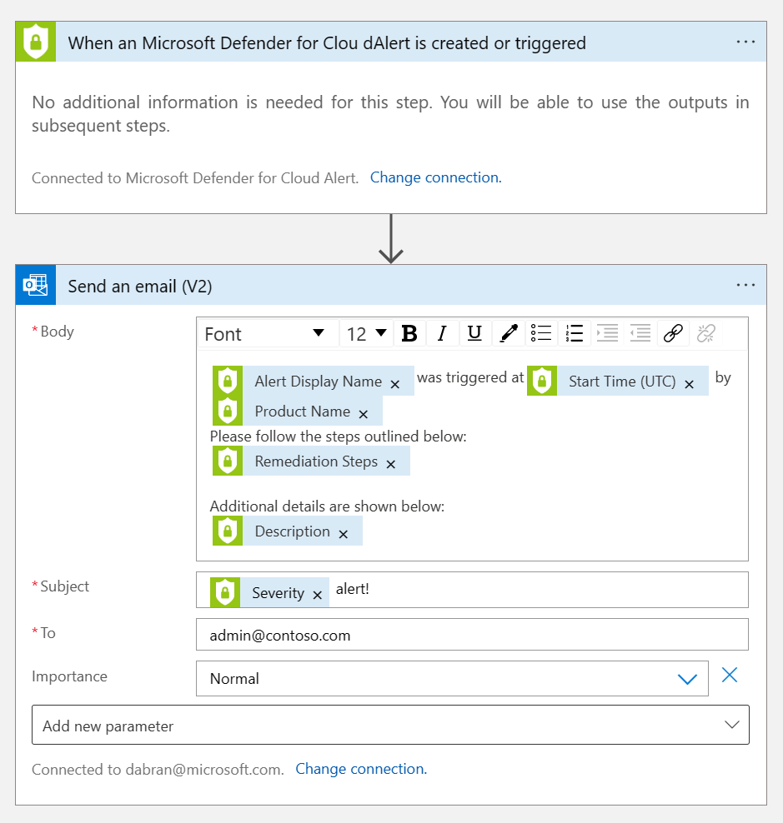
Define parameters for the Logic App
Logic App designer supports these Defender for Cloud triggers:
When a Microsoft Defender for Cloud Recommendation is created or triggered
When a Defender for Cloud Alert is created or triggered
When a Defender for Cloud regulatory compliance assessment is created or triggered

Slide 40
Configure workflow automation at scale
To deploy automation configurations to Azure subscriptions across your organization, use the Azure Policy 'DeployIfNotExist' policies below.
Goal | Policy | Policy ID
Workflow automation for security alerts | Deploy Workflow Automation for Microsoft Defender for Cloud alerts | f1525828-9a90-4fcf-be48-268cdd02361e
Workflow automation for security recommendations | Deploy Workflow Automation for Microsoft Defender for Cloud recommendations | 73d6ab6c-2475-4850-afd6-43795f3492ef
Workflow automation for regulatory compliance changes | Deploy Workflow Automation for Microsoft Defender for Cloud regulatory compliance | 509122b9-ddd9-47ba-a5f1-d0dac20be63c

Slide 41
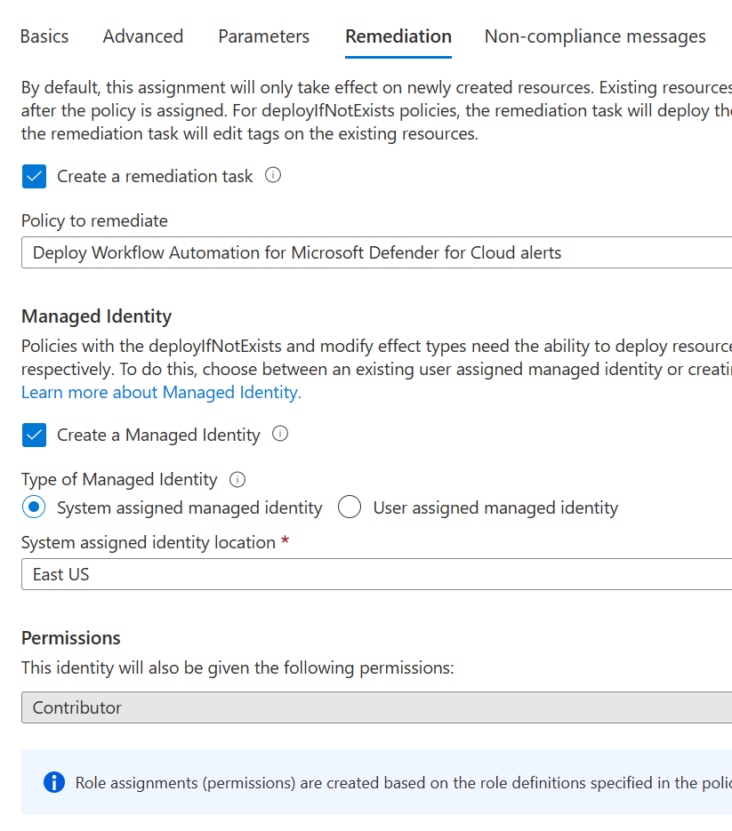
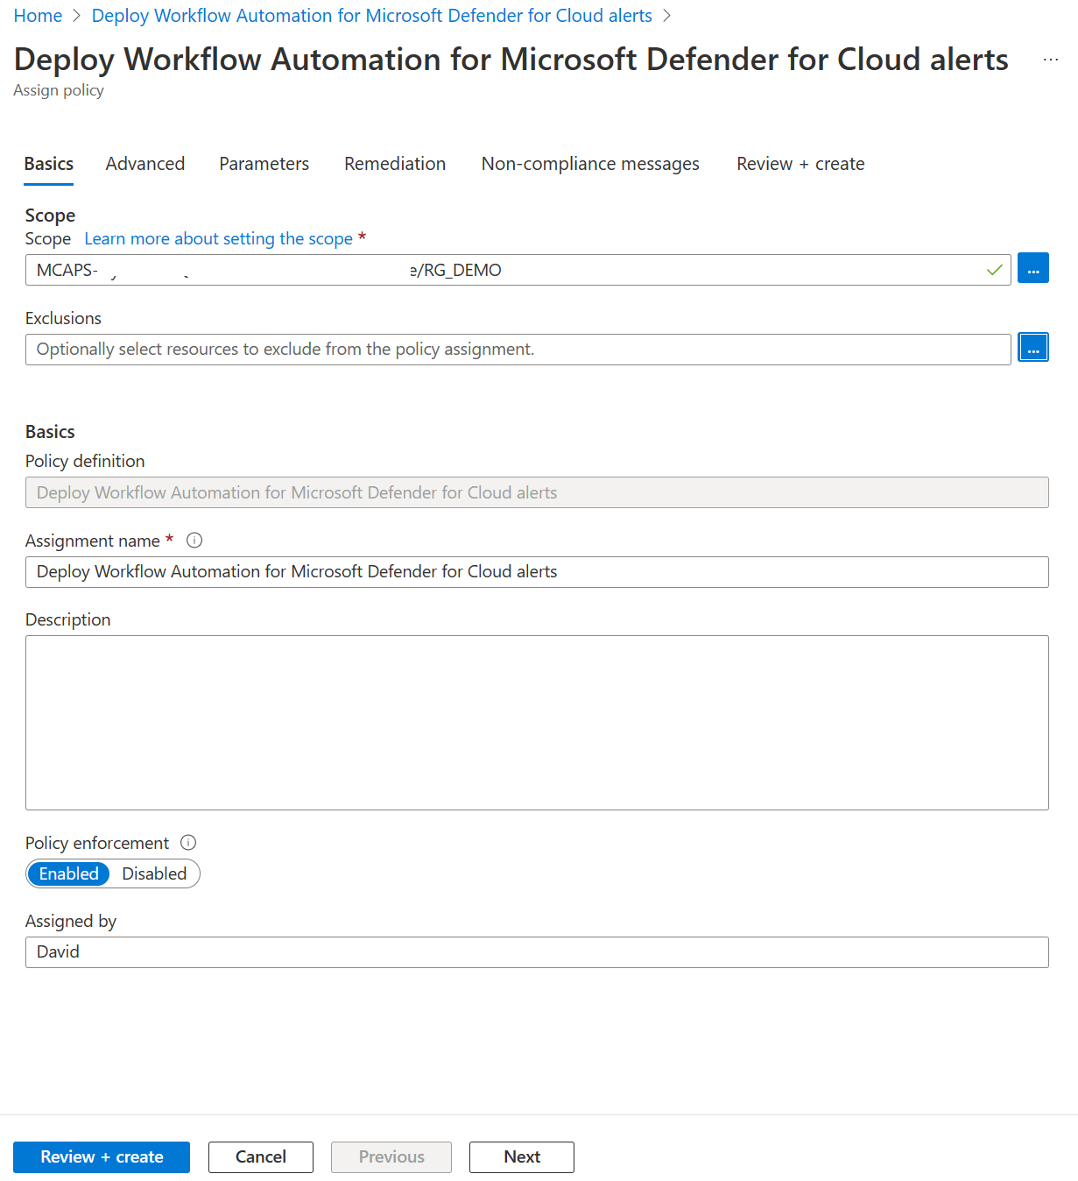
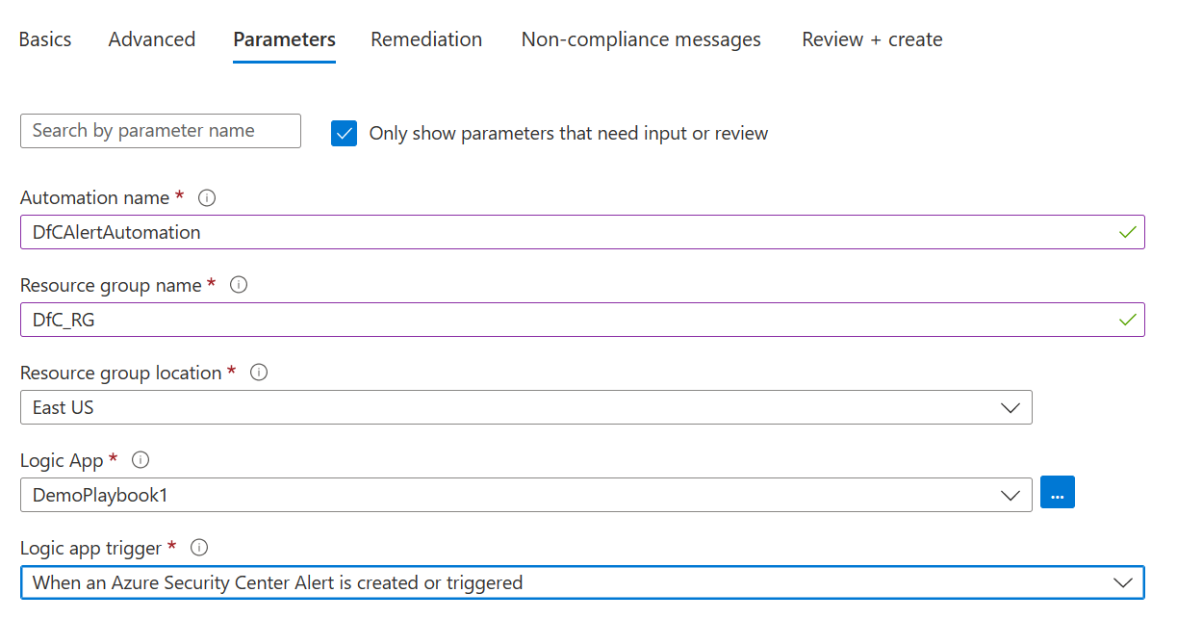
Create the automation

Slide 42
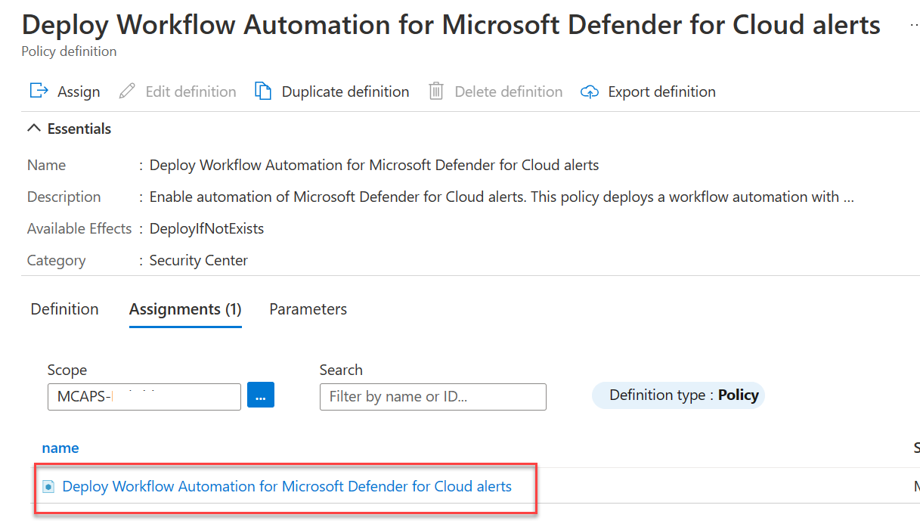
Automation applied via policy
Once the policy is configured, the automation will be applied across the scope in the policy definition

Slide 43
DEMO

Slide 44
Database and Storage Protection with Microsoft Defender

Slide 45
Defender for Databases

Slide 46
SQL Database Protection
Multiple layers of security for SQL databases
Securing your database
Firewall
Users & permissions
Connection string
encryption
Securing your data
Encryption
Data masking
Row-level security
Securing changes to your data
Application and user activity auditing
Application
Azure SQL Database

Slide 47





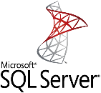
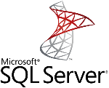


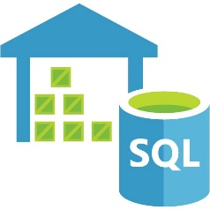
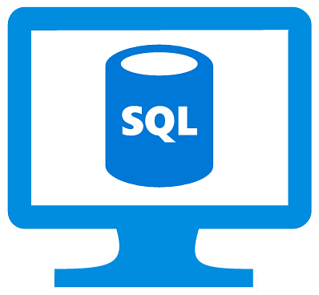

Microsoft Defender for SQL multi-cloud support
Azure Arc enabled SQL Server
(2012, 2014, 2016, 2017, 2019)
Azure Sentinel
Azure Security Center
Azure Defender for SQL
Log Analytics Workspace
MMA Agent
SQL Server
On AWS EC2
SQL Server
On Prem
SQL Server
On Google Cloud
Azure SQL Database
Azure SQL
Managed Instance
Azure Synapse Analytics (DHW)
SQL server
on Azure VM
Azure Cloud
Private Datacenter / Other Clouds
applications
!
Advanced Threat Protection : detect unusual and harmful attempts to breach SQL servers across hybrid estate
Vulnerability Assessment : discover and remediate security misconfigurations in SQL servers across hybrid estate

Slide 48
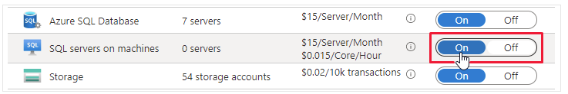
Supported SQL environments
Microsoft Defender for SQL is made up of two separate Defender plans:
Microsoft Defender for Azure SQL database servers:
  Azure SQL Database
  Azure SQL Managed Instance
  Dedicated SQL pool in Azure Synapse
Microsoft Defender for SQL servers on machines protects:
  SQL Server on Virtual Machines
  On-premises SQL servers:
    Azure Arc enabled SQL Server
    SQL Server running on Windows machines without Azure Arc

Slide 49
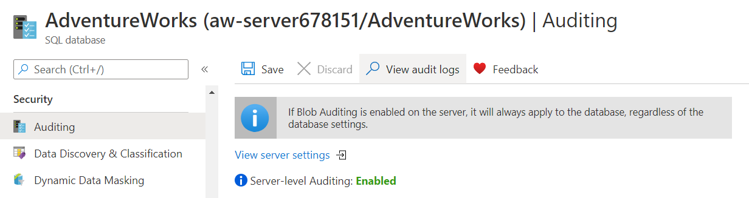
Enable auditing for SQL database
Enable Defender for SQL on every server and database; alerts can be customized at the database level, if needed.
SQL Database Auditing is not required by Defender for SQL, but is highly recommended
Decide if Auditing will be enabled for the databases, servers or managed instances

Slide 50
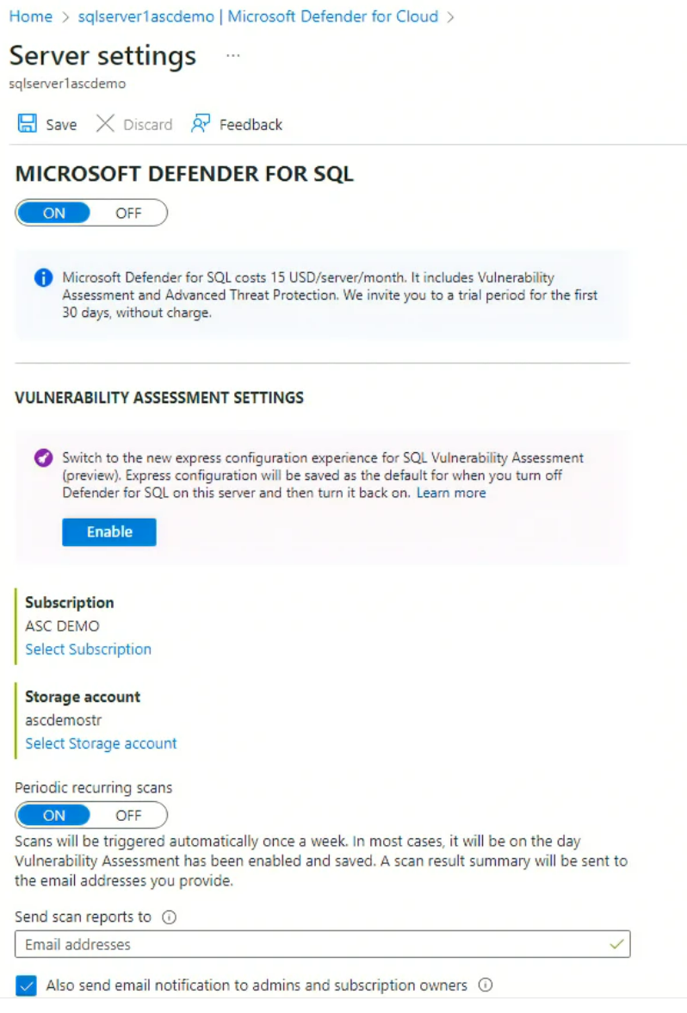
Configure Vulnerability Assessment
Defender for SQL uses storage accounts to store Audit Logs and Vulnerability Assessment scans.
Configuring the Microsoft Defender SQL Vulnerability Assessment includes:
Creating a storage account where scan results for all databases on the server or managed instance will be stored
Setting vulnerability assessments to automatically run weekly scans
Selecting recipients for scan result emails
A
B
C

Slide 51
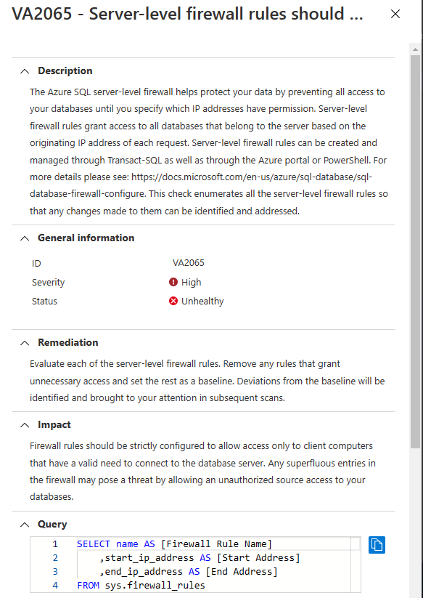
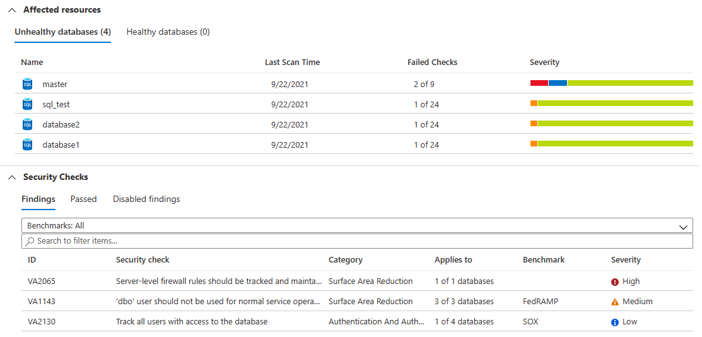
Review Vulnerability Assessment Scans and create baselines
Review Initial Vulnerability Assessment scan
Decide what failed checks must be addressed or defined as part of baseline
Manage vulnerability assessments using PowerShell, if desired.

Slide 52











Protect against common SQL threats
SQL brute-force (external)
SQL injection (external)
Data exfiltration (insider)
Azure Resource Management
Recommendations
Disable 'sa' login
Disable ‘xp_cmdshell‘
Detects
Potential SQL Injection
SQL brute force
Cryptominer in a VM
Potential data exfiltration
Web App
Azure SQL
Blob storage
Azure Key Vault
crypto miner
Azure Container Registry
Azure Kubernetes Services
SQL server on Azure VM
Azure DNS
Azure Resource Management
Azure Cloud

Slide 53
Defender for Storage

Slide 54




Microsoft Defender for Storage – Detections Suite
Suspicious access patterns
Access from a Tor exit node
Access from a suspicious IP address
Unusual anonymous access
Access from an unusual location
Access from unusual application
Suspicious activities
Unusual amount of data extracted
Unusual access inspection
Unusual change of access permissions
Unusual data exploration
Unusual deletion
Upload of malicious content
Phishing content hosted on a storage account
Upload of potential malware (based on hash reputation)
Unusual upload of .cspkg
Unusual upload of .exe
Playbooks for automatic remediation – move or delete blob on approval

Slide 55
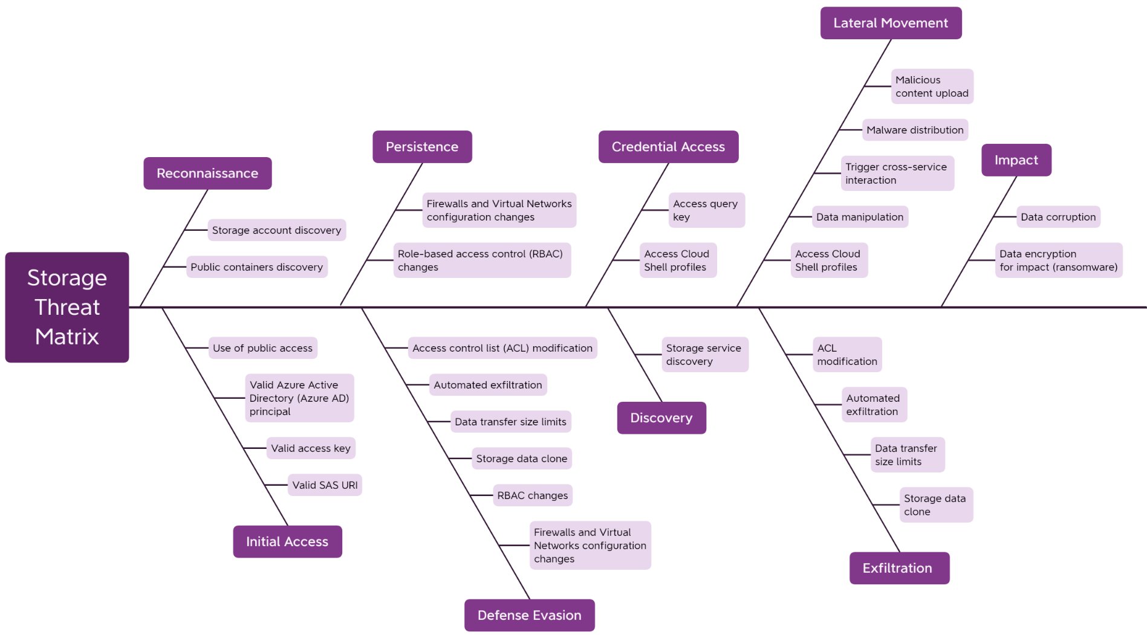
Security threats in cloud-based storage services

Slide 56




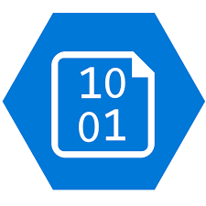




Detection and Remediation
ENABLE
ALERT
REMEDIATE
1
2
3
Attacker
Investigate in
Azure Sentinel
SecOps
Security alert
Threat
remediated
One-click
enablement
Blobs, Files,
ADLS Gen2
Enriched with
Microsoft Threat Intelligence
Admin
Storage protected by
Microsoft Defender for Storage
Automatic response
Azure Native Security
Built-in within Azure with 1-click enablement. Supports Azure Blob, Azure Files and Data Lakes
Rich Detection Suite
Covering top Storage threats powered by Microsoft Threat Intelligence
Response at scale
Reduce frictions preventing and responding to top threats
Centralized & Integrated
Centralize security across all data assets managed by Azure and built-in integration services such as Azure Sentinel

Slide 57

Defender for Azure Storage Alerts Overview
Microsoft Defender for Storage can detect and alert on the following anomalies:
Unusual Location Access
Unusual Application Access
Anonymous Access
Access from a Tor Exit Node
Unusual .cspkg Upload
Unusual Access Permission Change
Unusual Access Inspection
Unusual Data Exploration
Unusual Data Extraction
Unusual Delete Operation
Potential Malware Upload
Unusual .exe Upload
Access from a Suspicious IP Address
Possible Phishing Content
Reference table for all security alerts in Microsoft Defender for Cloud | Microsoft Learn

Slide 58

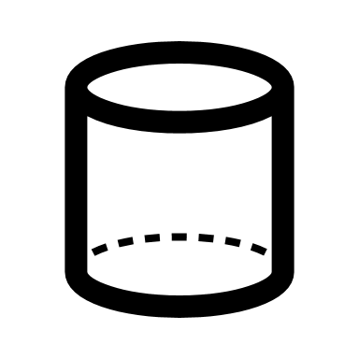
Identifying threats with Microsoft Defender for Storage
Looks for:
  Suspicious access patterns
  Suspicious activities
  Upload of malicious content
Alerts can be exported to SIEM or other external tools
Hash reputation analysis compares hashes of uploaded files with known viruses, trojans, spyware and ransomware

Slide 59
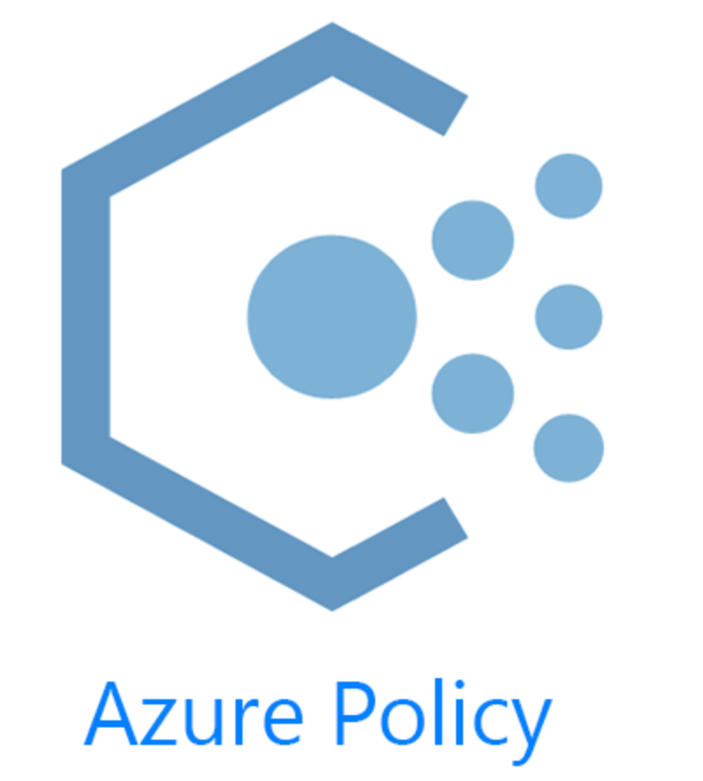
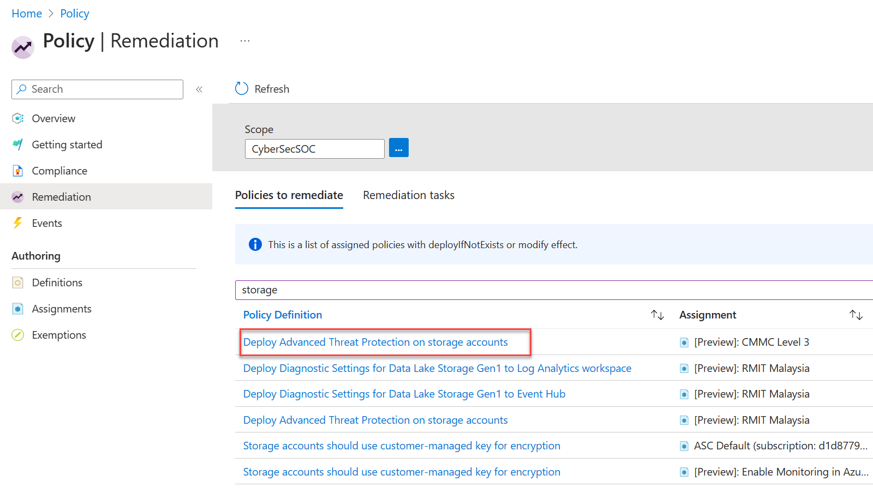
Deploying Defender for Storage: Azure Policy
Use Azure Policy to deploy Defender for Storage to your storage locations
Can be aligned to compliance regulations, as well

Slide 60
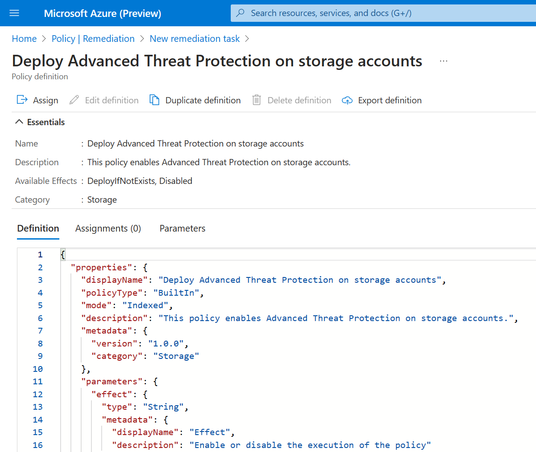
Azure Policy for Storage
Examples of policy settings for Defender for Storage
Ensure only HTTPS traffic is allowed
Allowed storage account SKUs
Customer-managed keys (CMKs) must be used
Public access is to storage accounts is not allowed
Private link connections to storage accounts must be used
Defender for Azure Storage must be used to protect storage accounts

Slide 61
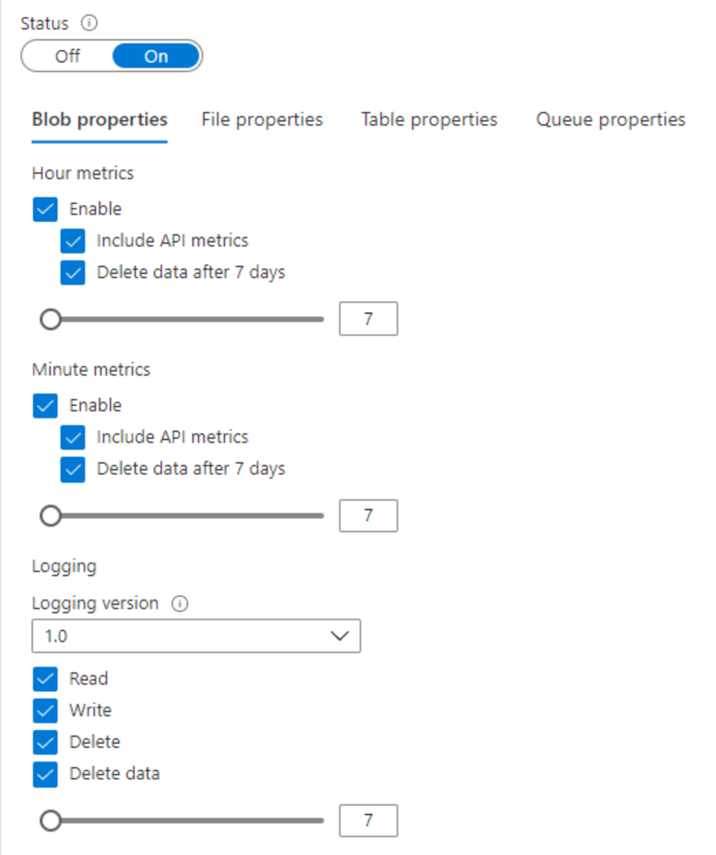
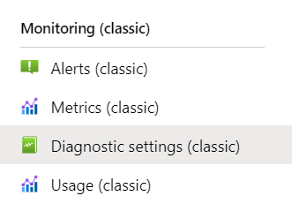
Logging with
Azure Storage Analytics
Makes detailed information about successful, failed and anonymous requests to a storage account available for alert investigations

Slide 62
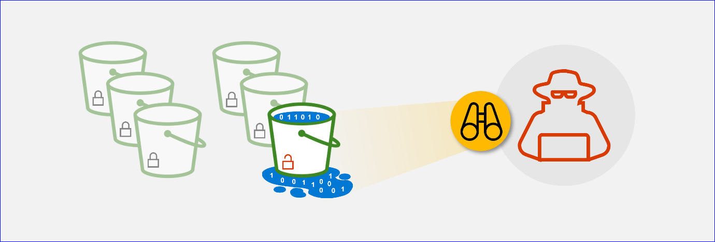
Defender for Storage protects against “blob-hunting”
Data exfiltration from unsecured storage (whether Azure, AWS or GCP) by threat actors is extremely common
Your customers may think their storage is secure. It’s probably not.
Hardening security on public storage can be done quickly and painlessly.
Protect your storage resources against blob hunting (microsoft.com)

Slide 63
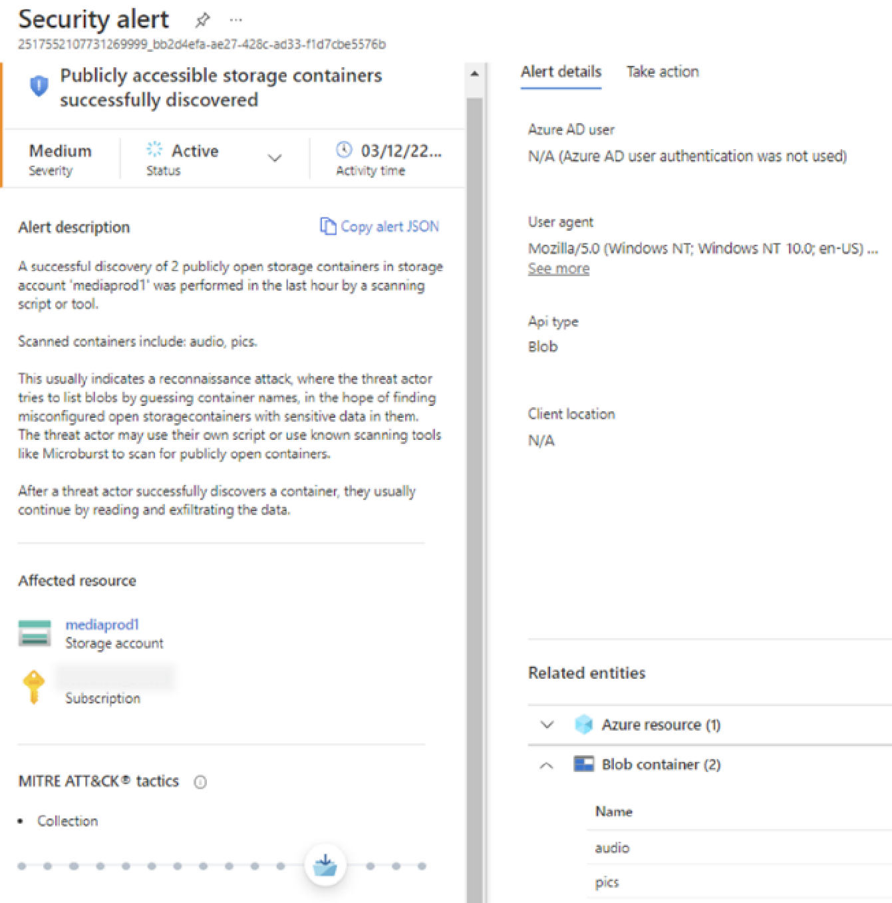
Blob hunting detection with Defender for Storage
Detects:
Successful and failed scanning attempts
Unusual unauthenticated access to containers
Data exfiltration
Containers access level misconfiguration

Slide 64
Thank you!

